Slide 1
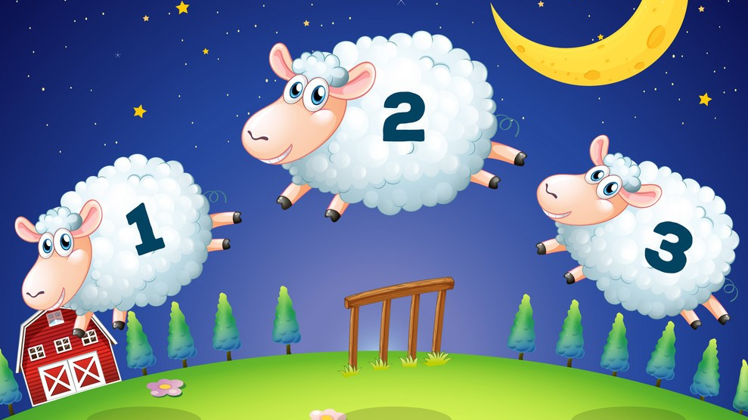
Bacteria counting
Image processing
mini-project
Midterm presentation

Slide 2

Table of content
Design phase
Objectives and technologies
Analysis
Exploration tree
Processing tree
Experiments
Trivial
K-means
Watershed
K-means + watershed
Blob detection
Maxime Geminiani
University of Fribourg
Master Benefri
Mini-project midterm
2/19

Slide 3
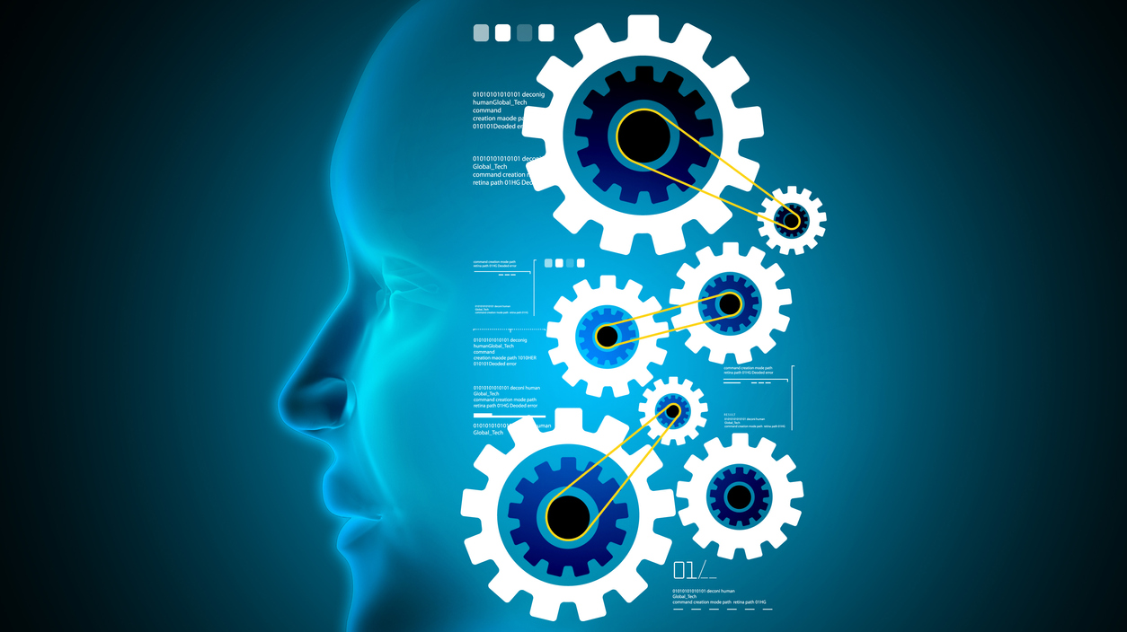
1. Design phase
Analysis
Planification
Maxime Geminiani
University of Fribourg
Master Benefri
Mini-project midterm
3/19

Slide 4
1.1 Objectives and technologies
Objectives
Count bacteria
Side challenge: Rebuild contours ?
Dataset: 10 images
Experiment, combine, analyse, compare
Technology
Python
OpenCV2
Visual studio code, jupyter notebooks
Maxime Geminiani
University of Fribourg
Master Benefri
Mini-project midterm
4/19

Slide 5
1.2 Analysis
Dataset analysis
Convenient points
Not many overlaps
Color domains
Sure background / No luminosity noise
Hot points
Irregular bacteria shapes
Bacteria proximity
Blurriness
Planned methods
Histogram analysis
Binarisation
Edge detection - Canny
Segmentation – Watershed
Pattern matching – Find ellipsis
Additional effort
Can we pre-process to use the blue effect ?
Maxime Geminiani
University of Fribourg
Master Benefri
Mini-project midterm
5/19

Slide 6
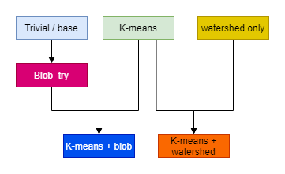
1.3 Exploration tree
Unexpected developments
Can we pre-process to use the blue effect ?
K-means
Unpromising
Hough circles
Blobs ?
Reality
Watershed : Distance transform
Maxime Geminiani
University of Fribourg
Master Benefri
Mini-project midterm
6/19

Slide 7
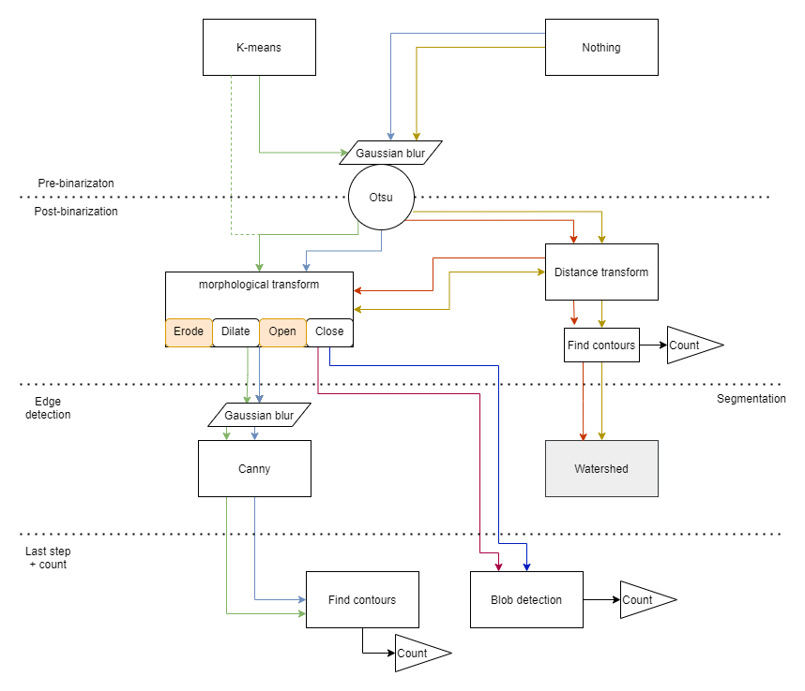
1.4 Processing tree
Reusability
parameters/tuning
Combinations
More tuning
Maxime Geminiani
University of Fribourg
Master Benefri
Mini-project midterm
7/19

Slide 8

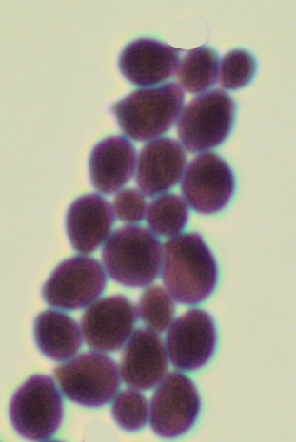
2. Experiments
Dataset 04
Basic case
Full chain
Maxime Geminiani
University of Fribourg
Master Benefri
Mini-project midterm
8/19

Slide 9
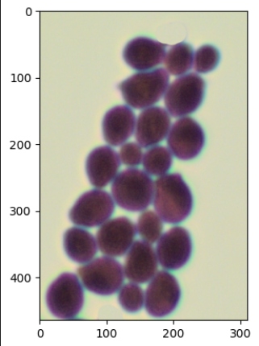
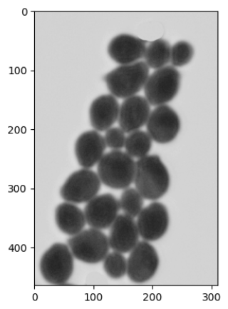
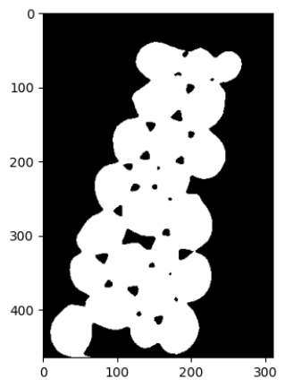
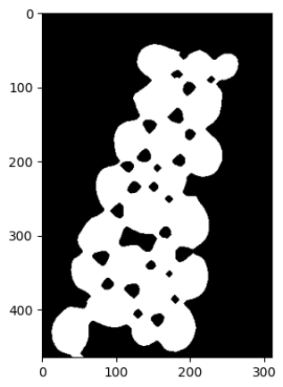
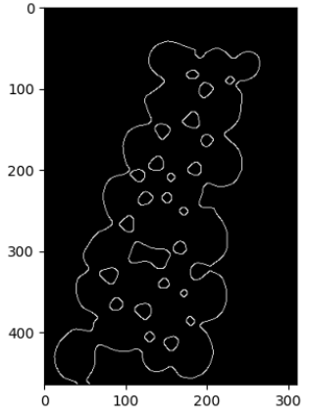

Trivial process
Original image
Grayscale
Otsu
Erode / Open
Canny
Contours
25 Contours found ?
Good first approximation / tentative
Mitigated results
Maxime Geminiani
University of Fribourg
Master Benefri
Mini-project midterm
9/19

Slide 10
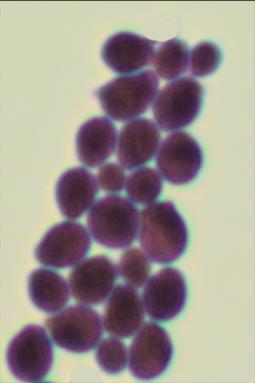
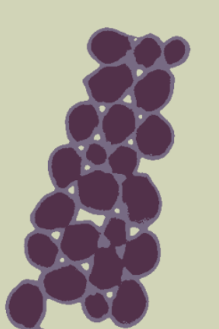

K-means
Apply K-means
K = 3
Suppress Median channel
Blue effect -> Background
Original image
Maxime Geminiani
University of Fribourg
Master Benefri
Mini-project midterm
10/19

Slide 11
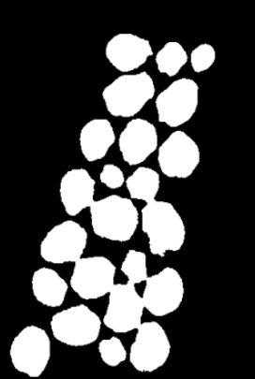
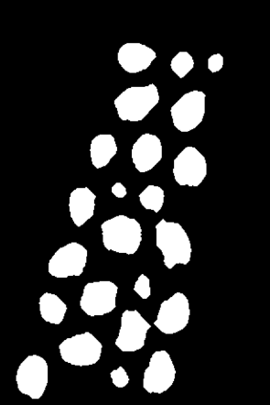
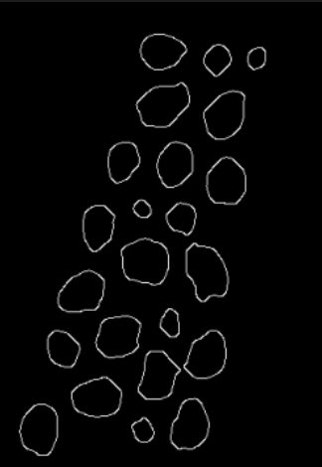

K-means
Binarise
Morph (Erode + Open)
Cany
Contour detection
Maxime Geminiani
University of Fribourg
Master Benefri
Mini-project midterm
11/19

Slide 12


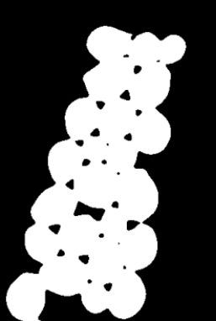
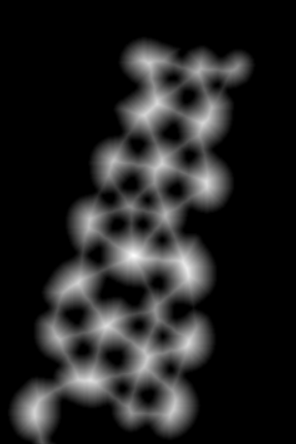
Watershed – dist transform
Original image
Binarize
Dist transform
Distance to background (0)
‘Skelettons’ maps
Maxime Geminiani
University of Fribourg
Master Benefri
Mini-project midterm
12/19

Slide 13
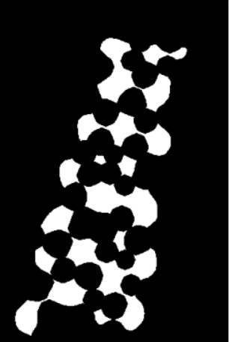
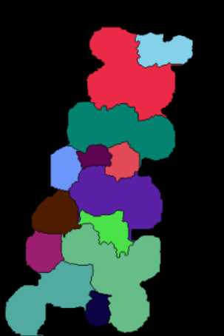

Watershed - results
Binarize distance transform Concept of marks
No morph applied
Execute watershed
Report contours
Maxime Geminiani
University of Fribourg
Master Benefri
Mini-project midterm
13/19

Slide 14
K-means + watershed
Apply K-means
K = 3
Suppress Median channel
Blue effect -> Background
Original image
Maxime Geminiani
University of Fribourg
Master Benefri
Mini-project midterm
14/19

Slide 15
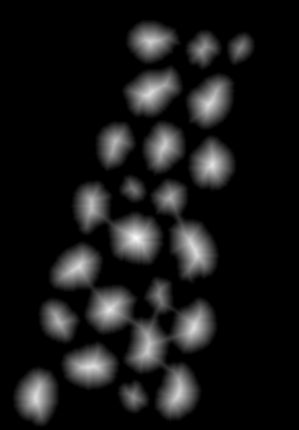
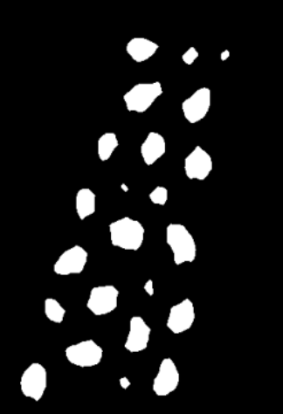
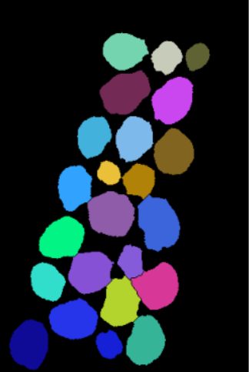

K-means + watershed
New dist transform
Open, binarize, Open
Watershed
Contours reporting
Highlight: Distance transform binarization, Challenge: How many morph operations ?
Untested: Different distance functions
Maxime Geminiani
University of Fribourg
Master Benefri
Mini-project midterm
15/19

Slide 16

Blobs – Preliminary test
Hough circle: Too precise
Problem of segmentation + counting zones
Missmatch Zone = Missmatch count
Blob detection - Patatoids
Maxime Geminiani
University of Fribourg
Master Benefri
Mini-project midterm
16/19

Slide 17
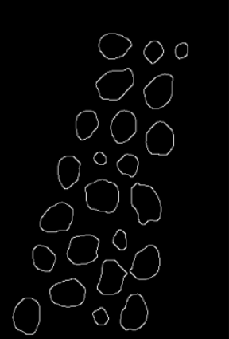
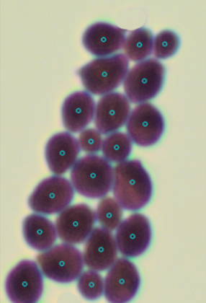

Blobs + Kmeans
Parameters
Area
Circularity
Convexity
Intertia ratio
Etc,,,
Maxime Geminiani
University of Fribourg
Master Benefri
Mini-project midterm
17/19

Slide 18
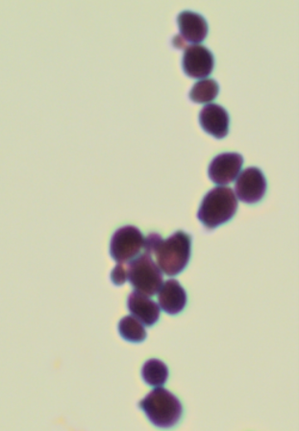
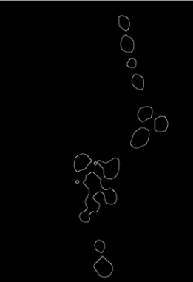
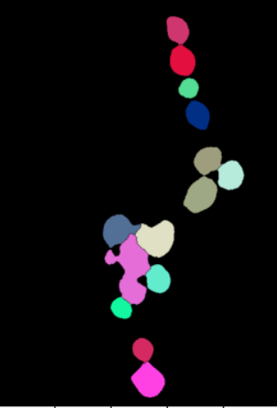

Problem Blobs could resolve
Dataset image 0017
K-means canny
K-means + watershed
Blob detection
Maxime Geminiani
University of Fribourg
Master Benefri
Mini-project midterm
18/19

Slide 19
Future work
Focus on promising combinations
K-means
K-means, watershed
Blob ?
Focus on fine-tuning
Traduction to python scripts
Input parameters
Result summary
Image labeling
Compare parameter values and results
Maxime Geminiani
University of Fribourg
Master Benefri
Mini-project midterm
19/19

